Slide 1
Collaboration Technologies, Knowledge Management and Social Enterprise
Module 7

Slide 2
Agenda
Collaboration Tools
Enterprise 2.0 revisited
Definitions
Brigg’s Patterns of Collaboration
Tool Selection
Multicultural Issues
KM
Social Enterprise
Adoption and Diffusion

Slide 3
Enterprise 2.0 Characteristics
Enterprise 2.0 is the integration of Web 2.0 technologies into an enterprise's business processes.
Web 2.0
Communication
Collaboration
Information Storage/Retrieval/Mining
Enterprise 2.0 technologies emphasize employee, partner and consumer collaboration.
Connectivity (internetworking)
Enterprise 2.0 implementations use a combination of social software and collaborative technologies like blogs, wikis, social networks
Utilizes Internet/Web/Mobile
Hardware (processing and storage architectures) is usually Cloud/SAAS
Notes:
RSS is Rich Site Summary or Real Simple Syndication

Slide 4
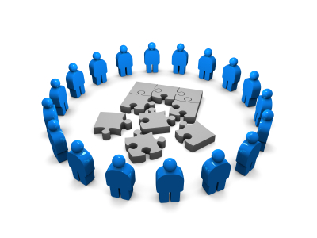
Benefits of Collaboration
People innovate faster in a collaborative workplace
Save time
Increase quality of output
When you work with a team, you utilize many strengths
Increase participation
More likely to have the right experts available
More likely to increase buy in for the result
Using resources to their fullest improves employee retention
Cooperation supports both team and individual goals

Slide 5
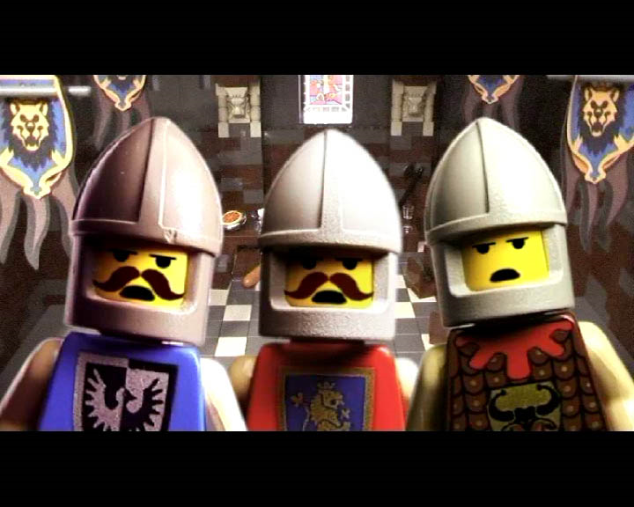
We need some shared definitions

Slide 6


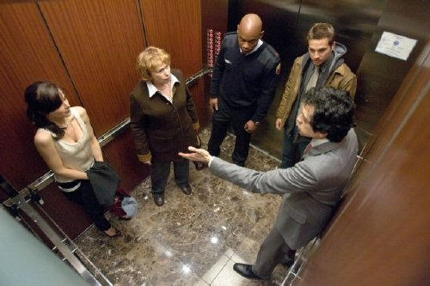
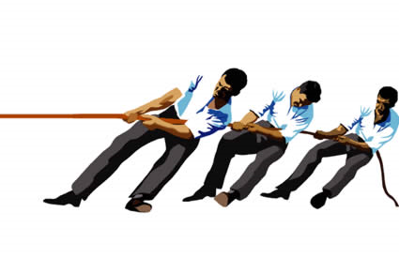
Group
Team
A Group is two or more individuals who share common interests or characteristics and whose members identify with each other due to similar traits.
Any group of people involved in the same activity. Team members work together toward a common goal and share responsibility for the team's success.

Slide 7
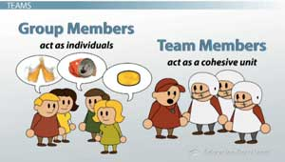
Teams are different from groups in 5 ways:
task orientation
Purpose
Interdependence
formal structure
familiarity among members.

Slide 8
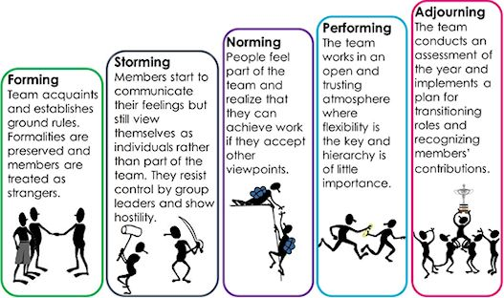
Team Development
This model of group development was first proposed by Bruce Tuckman in 1965, who maintained that these phases are all necessary and inevitable in order for the team to grow, to face up to challenges, to tackle problems, to find solutions, to plan work, and to deliver results.

Slide 9
Types of Teams
Standing [Work or Production]
Project
Ad-Hoc
“Virtual” [Inter-organizational]
Leaderless
Action
Notes:
Standing team is a group of employees working on recurring task
Project team is a group responsible for planning and executing a project
Ad-hoc team is short lived (like a training seminar, a class)
Virtual teams are geographically dispersed, are remote and meet online
Leaderless teams are ad-hoc, self directed (community groups)
In Action teams members volunteer to accomplish a particular task or to examine a particular issue. (Example is a red team to eradicate a spam infestation on your LAN)

Slide 10
Multiple levels of Collaboration Capability (in a team)
Low
Level 1 Collected Work :
Uncoordinated Individual Efforts
Sprinters
Degree of
Collaborative
Effort
Level 2 Coordinated Work:
Coordinated Individual Efforts
Relay
Level Concerted Work:
Concerted Team Effort
High
Crew

Slide 11
Level 1 Collected Work
Sprinters
Individual, uncoordinated effort toward team goal
Team productivity is sum of individual performances
Individualized Processes from Start to Finish
Examples are: Office Applications
MSWord group editing
Multiple spreadsheet editing
Powerpoint presentation passing

Slide 12
Level 2 Coordinated Work
Relay
Coordinated Efforts and Processes
Coordination, sharing, and hand-offs
Coordination Applications examples are
Workflow Applications

Slide 13
Level 3 Concerted Work
Crew
All team members work a process simultaneously to achieve the team goal
Repeatable Customized Process
Collaborative applications examples are:
GroupSystems

Slide 14
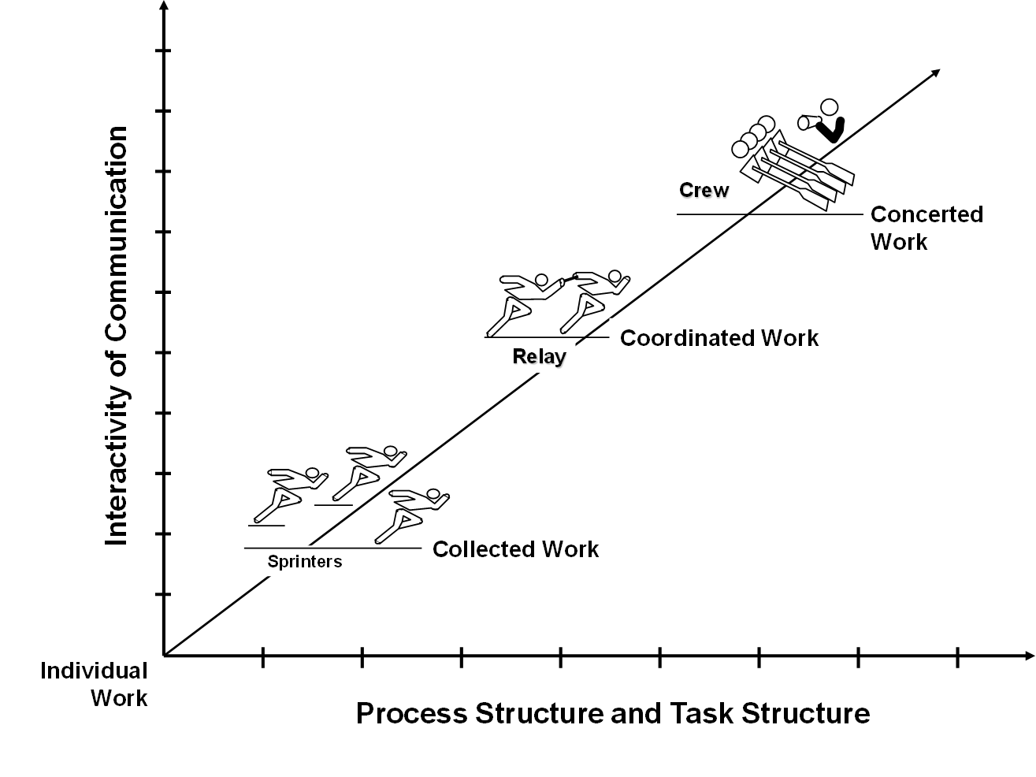
Hierarchy of Collaboration

Slide 15
What is a GSS?
Can also be referred to as group decision support systems (GDSS). GSS is any combination of hardware and software that is used to support group functions and processes.
A Group Support System permits modeling many different structured synchronous team interventions to support task oriented collaborative intellective work.

Slide 16
Collaboration
Group Systems
Share
Information
Generate
Ideas
Organize
Ideas
Poll
Consensus
Explore
Issues
Session
Planning
Knowledge Management
Organizational
Memory
Enterprise
Model
Corporate
Database
Intranet
World Wide
Web
FTP/Gopher

Slide 17
Group Systems
Virtual Collaboration
Collaboration
Share
Information
Generate
Ideas
Organize
Ideas
Poll
Consensus
Explore
Issues
NY
DC
DC
Boston
Session
Planning
LA
LA
SF
PIT
Paris
HK
SYD
NY
ATL
Knowledge Management
LON
DC
SF
Organizational
Memory
Enterprise
Model
Corporate
Database
Intranet
World Wide
Web
FTP/Gopher
CHI

Slide 18






Slide 19
Mind mapping
http://www.mindmeister.com
You should have gotten an invite for this activity
Click on a topic (it will be outlined in blue)
You may need to create a basic account
Let’s Look at Mind Meister

Slide 20
Processes - are repeatable patterns that generate predictable results
All meetings consist of collaboration patterns

Slide 21
A SEVEN-LAYER MODEL OF COLLABORATION FOR DESIGNERS OF
COLLABORATION SYSTEMS - Robert O. Briggs, Center for Collaboration Science, University of Nebraska at Omaha
Goals - A goal is a desired state or outcome. Deals with group goals and private goals. Collaboration is defined as joint effort toward a group goal.
Products - A product is a tangible or intangible artifact or outcome produced by the group’s labor.
Activities - Activities are sub-tasks that, when completed, yield the products that constitute attainment of the group goal.
Patterns of Collaboration - Patterns of collaboration are observable regularities of behavior and outcome that emerge over time in teamwork.
Techniques - A collaboration technique is a reusable procedure for invoking useful interactions among people working toward a group goal.
Tools - Collaboration tools are artifacts or apparatus used in performing an operation for moving a group toward its goals.
Scripts - A script is everything team members say to each other and do with their tools to move toward the group goal. Scripts may be internal or external, tacit or explicitly captured as documentation.

Slide 22
Briggs’ Patterns of Collaboration
Generate
To move from having fewer concepts to having more concepts in the set of ideas shared by the group.
Reduce
Move from having many concepts to a focus on a few deemed worthy of further attention
Clarify
Move from less to more mutual understanding about a concept
Organize
Move from having less to more understanding of the relationships among concepts
Evaluate
Move from less to more understanding of the benefit of concepts toward attaining a goal relative to one or more criteria.
Commit
Move from less to more commitment among stakeholders about an action toward the stated goal

Slide 23
Evaluating Tools can be done with Patterns in mind
Ask yourself:
What types of tools support the patterns of collaboration you plan to use?
Can the tool assist in structuring the meeting?
Can the tool assist in structuring the outcomes?

Slide 24
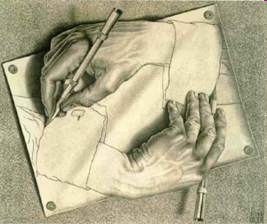
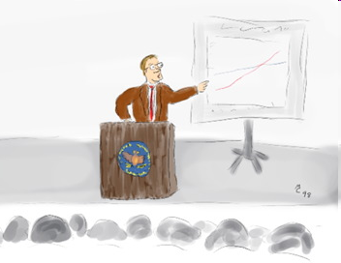
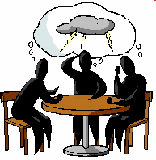
Kinds of processes you want to accomplish at meetings
Kinds of meetings
Briefing
Presentation
Training
Status
Problem Solving
Ideation
Knowledge Acquisition
Knowledge Exposition
Decision Making
Execution
Group Writing
Group Modeling
Social
Kick Off
Team Building
Celebration
Notes:
Many/Most meetings are compound
[this is not a complete list]
Discuss that each type is made up of components… These processes are made up of objects called “thinklets”. And each thnklet has properties and methods. We have about 100 thinklets catalogued – but many more exist most likely.

Slide 25
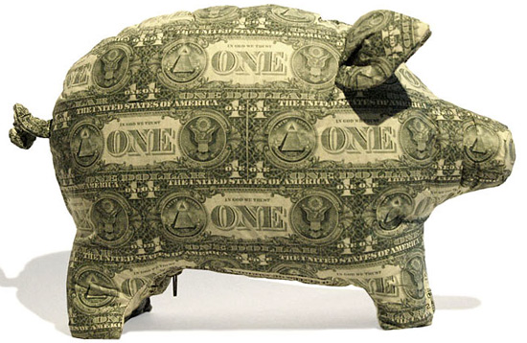
But I am not made out of money.
How do I select Web2.0 tools that aren’t $1,000 a seat?

Slide 26

Caveat
Simply adding technology alone never solves a significant problem

Slide 27
Now let’s Look at Podio
http://www.podio.com
You should have gotten an invite from me for this tool.

Slide 28
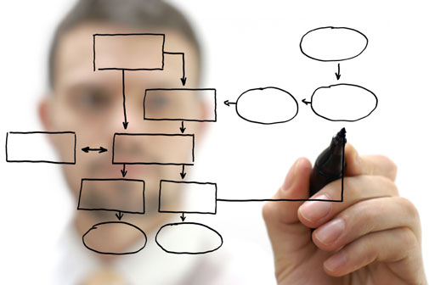
It’s the process, silly
Notes:
Agenda, dispute/conflict resolution, communication ground rules

Slide 29
Evaluate the solution
Scope the Context
[Feasibility]
Find and define the problem
Generate and test candidate solutions
Pick and implement a solution
Define
the
Business
Problem
Define the
Team
Processes
Required
Define the
Technology
Select & Configure
Product
Execute Solution
Use Cases
Evaluation Criteria
Groupware Categories
Eval. options against criteria for relevant use cases

Slide 30
Can we map tools to meetings?
Briefing
Presentation
Training
Status
Problem Solving
Ideation
Knowledge Acquisition
Knowledge Exposition
Decision Making
Execution
Group Writing
Group Modeling
Social
Kick Off
Team Building
Celebration
Streaming tools
Web conference
Desktop sharing
Audio/Video conference
GSS Suites
MindMapping
Wikis
Group Modeling
Voting/Polling
Office Suites
Collaborative Authoring
Collaborative Modeling
Messaging
Micro-blogging
Social Networking Systems
Streaming tools
Notes:
Many/Most meetings are compound
[this is not a complete list]

Slide 31

How do we differentiate among products in the same category?
Tool Selection

Slide 32








Slide 33
Collaboration Capability Schema
Core capabilities | Primary characteristics of a collaboration technology that provide the group with the means to take action toward attaining their goals.
Data Content | Kinds of contributions users can add using core capabilities, e.g. text, graphics, voice, video.
Data relationships | Kinds of relationships users can establish among their contributions, e.g. collection, ordinal, hierarchical, network.
Data limits | The kinds of limits that are or can be imposed on contributions, e.g. size, duration, content.
Data persistence | The degree to which contributions can be made permanent.
Actions | Kinds of actions that users in each role can take with respect to contributions to a technology: add, receive/view, associate, edit, move, evaluate, and delete.
Synchronicity | Expected delay between the time a person executes an action and the time s/he could reasonably expect that other users could perceive the effects of that action. E.g. instantly, within seconds, within minutes, within hours.

Slide 34
Collaboration Capability Schema
Identifiability | Degree to which users can determine who executed an action. E.g. full Identifiability, full anonymity, identification by role, identification by pseudonym.
Access controls | The kinds of limits that may be placed on user’s ability to access a technology and act on its contents. E.g. login name, password, invitation, smart card.
Roles | The degree to which a technology affords differentiation in access and action by sub-group, e.g. leaders, participants, observers.
Awareness indicators | Ways users know who else has access to the system, who is currently present in the system, what contributions others are viewing, what they are doing.
Interruption alerts | Ways that participants are notified that something or someone in the system requires their attention.
Instructions | Ways a technology implementation provides process guidance to a user about what they may contribute, what actions they may take, and the significance of those actions.

Slide 35

What does it mean when I say…
Lets consider three dimensions of virtuality in the workplace
“We are . working virtually”

Slide 36
4d matrix of team types
Same Time
Different Time
Large Group
Different Culture
Small Group
Same Place
Different Place
Same Culture
A Fourth Key Dimension is Culture

Slide 37
Meeting One
Repositories
Meeting Two

Slide 38
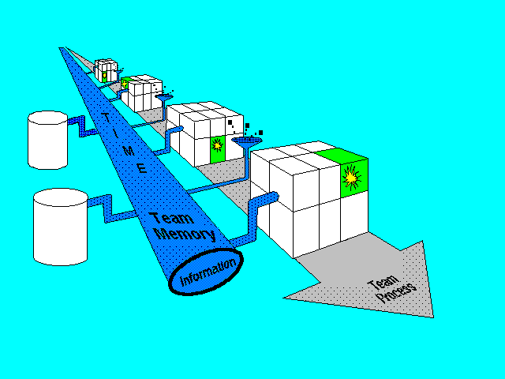
Virtual Project Support
Information generated between group-to-group
and distributed meetings
Corporate
Database
Different Time
Same Time
Small Group
External
Information
Services
Large Group
Virutal
Meetig
(office)
FTF
Meeting
Room
Group
to
Group
Adapted from J. Morrison, 1992 UofAZMIS

Slide 39

Let’s start with a Hangout!
Note: We will not review Google Hangouts (most of you already use it!!)

Slide 40

National Culture Models for Virtual Teaming

Slide 41
Multi-Cultural Issues
Do you have these?
Where do they show up?
How do you manage them?

Slide 42
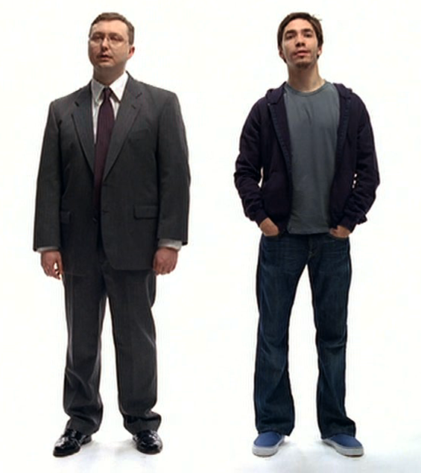
Types of Cultural dimensions
National Culture
Organizational Culture
Professional Culture

Slide 43
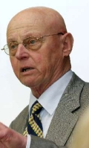
Professor Geert Hofstede
Social Psychologist and former IBM employee conducted one of the most comprehensive studies of how values in the workplace are influenced by culture. He broke down these values into
5 Dimensions of National Culture
Power Distance index
Power Distance Index (PDI) - focuses on the degree of equality, or inequality, between people in the country's society. A High Power Distance ranking indicates that inequalities of power and wealth have been allowed to grow within the society.
Uncertainty Avoidance -Tolerance
Uncertainty Avoidance Index (UAI) - focuses on the level of tolerance for uncertainty and ambiguity within the society - i.e. unstructured situations. A High Uncertainty Avoidance ranking indicates the country has a low tolerance for uncertainty and ambiguity.

Slide 44
Geert Hofstede
Individualism-Collectivism
Individualism (IDV) - focuses on the degree the society reinforces individual or collective achievement and interpersonal relationships. A High Individualism ranking indicates that individuality and individual rights are paramount within the society.
Masculinity-Femininity
Masculinity (MAS) - It depicts the degree to which masculine traits like authority, assertiveness, performance and success are preferred to female characteristics like personal relationships, quality of life, service and welfare.
Long term-Short term Time Horizon
Long-Term Orientation (LTO) - focuses on the degree the society embraces, or does not embrace, long-term devotion to traditional, forward thinking values. High Long-Term Orientation ranking indicates the country prescribes to the values of long-term commitments and respect for tradition.

Slide 45
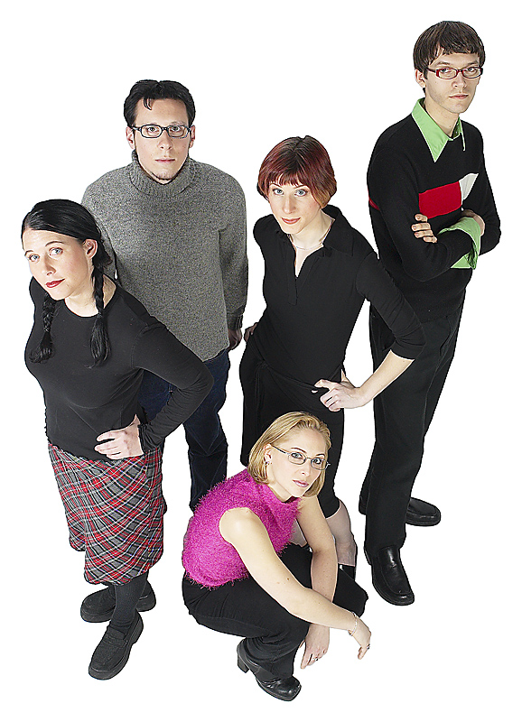
Gen Y’s expectations of the workplace
Want transferable skills that support job mobility
Expect to have many jobs over their lifetimes
High value placed on engagement and attention from companies, bosses, mentors
Broad attention span and multitasking
Communicate via multiple channels
High use of computer games, have developed job-related skills via gaming
Willing to trade off between income and job demands
Less willing to unquestioningly adhere to “traditional” norms around the workplace
From various sources, including Carolyn Martin’s and Bruce Tulgan’s work on Generation Y in the workplace.
Notes:
Points above from various sources, including Carolyn Martin’s and Bruce Tulgan’s work on Generation Y in the workplace, and also Deloitte & Touche’s projects with Institute for the Future related to Generation Y in the workforce.
Evidence shows that Gen Y thinks job mobility is important -- when combined with other Gen Y attitudinal research, job mobility appears to be important because it provides a variety of advantages (the opportunity to develop skills, allows for variety in job tasks, ability for worker to select between different jobs vs. being “locked in” to one job without a viable alternative) – thus improving the worker’s opportunity to control the conditions of his / her working and personal life.
Findings show, however, that some Gen Yers are willing (and some may prefer) to find mobility inside a company, rather than have to leave a company to find a new position. Many Gen Y are showing interest in company benefits such as health care and retirement programs; in the past, it was unusual for employees in their 20s to say that such programs were a priority for them.
Some researchers have speculated that Gen Y has seen the upheaval in the workforce (layoffs, reductions in benefits) and how this upheaval has impacted their parents and older workers and therefore Gen Y are highly aware of how these employee benefits (or the lack of them) can impact an employee’s life.
Findings from the IFTF studies for Deloitte show that Gen Y expects to have a number of jobs in their careers – more jobs than they would choose or prefer to have, which implies that they expect to be required to change jobs due to external demands (not only due to their own choice).

Slide 46

Mobile technologies are transforming work and life
Laptops are increasingly the assumed standard for personal computers.
Many companies say that out-of-office work is “nothing special – just part of how we do business now.”
Urban nomads:
People connected anywhere, anyplace
Not just for business travelers, but for people going about their daily lives in their local environment
A single smart device (cellphone+internet) taking the place of multiple pieces of equipment
Assumption that you can access your personal files from any device
Quote from The Telework Coalition’s Teleworking Benchmarking Study Best Practices for Large-Scale Implementation in Private and Public Sector Organizations – Executive Summary (2006).
“Urban nomads” from The Economist - Mobile Edition (April 10, 2008).
Notes:
Laptops are increasingly the assumed common computer for business and for individuals. The Wall Street Journal’s Walt Mossberg now does his annual review of “best PCs for businesspeople” for laptops only, saying that the desktop versions are simply the non-mobile variant of the laptop (rather than the traditional view that the laptop was the mobile variant of the desktop).
Quote from the Telework Coalition’s Telework Benchmarking Study Best Practices for Large-Scale Implementation in Private and Public Sector Organizations” Executive Summary dated 2006. Report also identified common technologies used by businesses to enable telework: laptops, VPNs, extended help desk support (often 24/7 and outsourced) increasingly VOIP, increasingly file sharing and collaboration tools.
The Economist special report “Mobile Edition” April 10, 2008 had several articles on the trends in mobile technology and the behaviors of “urban nomads.”
The “third space” is a concept of a location other than home and work, for people to gather; these third spaces are considered key to community formation and activity. The concept was discussed by Ray Oldenburg in his book The Great Good Place. Coffee shops and cafes are most often mentioned as a third space.

Slide 47

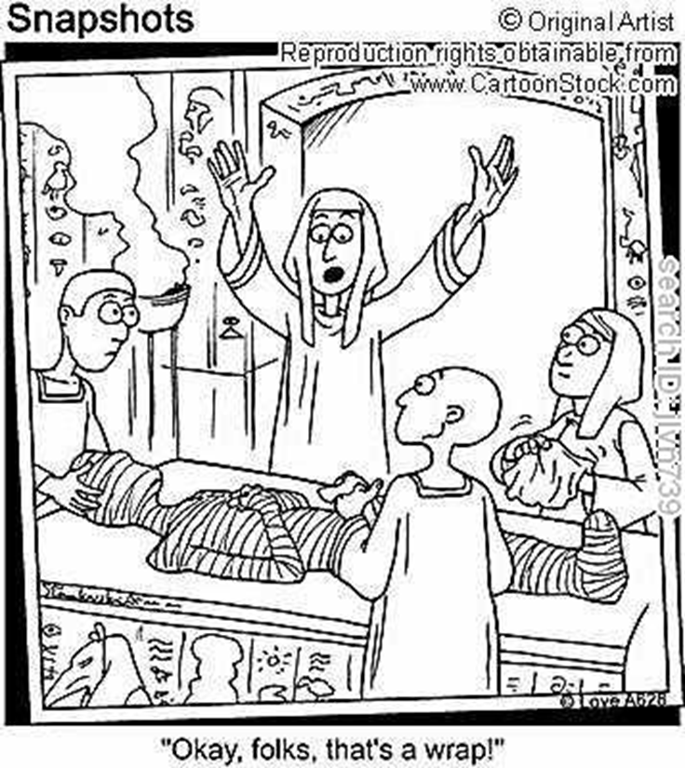

Slide 48
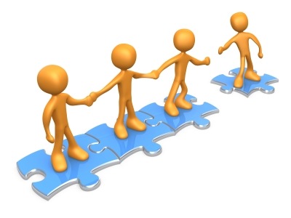
KM and CMS
http://www.knowledge-management-tools.net/knowledge-management-model.html
“Communities come to life when they fulfill an ongoing need in people’s lives. To create a successful community, you’ll need to first understand why you’re building it and who you’re building it for; and then express your vision in the design, technology and policies of your community.” – Amy-Jo Kim, Community Building on the Web

Slide 49
Collaboration
Opportunities for Knowledge Creation
Opportunities for Knowledge sharing
Knowledge types
Tacit (what lives between the ears)
Explicit (what has been captured and stored)
Information overload:
Knowledge workers spend between 15 and 30 percent of their time searching for information, and these searches are successful less than 50 percent of the time. (this is a KM issue)

Slide 50
Out of Collaboration comes Knowledge?
Collaboration creates massive quantities of data and experience
It rarely gets shared outside of the immediate group involved
Organizations are trying to figure out how to keep from repeating experiences (learning)
We have been trying for nearly 20 years (mid 90s)

Slide 51
The Changing Face of the Knowledge Business
Economic reliance on knowledge workers is increasing.
About 40% of the US workforce are classified as knowledge workers
Customers and employers want a more integrated approach.
There won’t be enough of them
Their expectations are different
Technology will transform when, where and how work is done.

Slide 52
Knowledge Management in the Enterprise
Knowledge
Knowledge Sharing vs Knowledge Management
CMS (underlying technology)

Slide 53
Understanding Data, Information, Knowledge and Inter-Relations
This is the DIK pyramid
Based on systems-theory thinking – that one leads to the other by simple aggregation
– what do you think ???
?
Knowledge
Information
Data

Slide 54
Difference between data, information, knowledge, wisdom
You’re outside Washington, DC driving to the airport to catch a plane to New York for a meeting.
Data: 10, 34, 25.
Information: a weather station 10 miles from Washington National Airport reports sleet, temperature 34 degrees, wind out of the West at 25 mph.
Knowledge: you know the weather will cause delays or cancellations and you may miss your meeting.
Wisdom: you reserve a seat on the next train so you get to your meeting on time.

Slide 55
What Is Knowledge?
DEFINITIONS
Understanding via experience
A person’s range of information
Accumulation of facts or procedural rules
Types of Knowledge:
Know-What: Facts
Know-Why: Analysis
Know-Who: Politics
Know-Where: Marketing
Know-When: Strategy
Know-How: Expertise

Slide 56


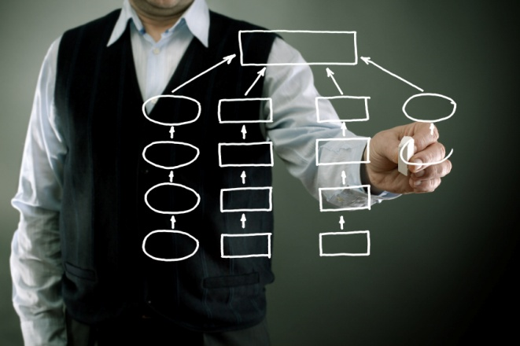
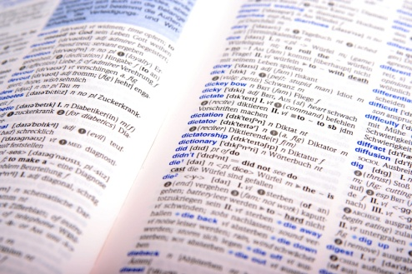
Explicit and Tacit Knowledge
Tacit
Tacit
Explicit
Explicit
Socialization
Externalization
Internalization
Combination
Notes:
TACIT is a kind of knowledge that is difficult to transfer to another person by means of writing it down or verbalizing it

Slide 57

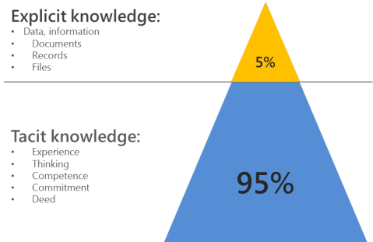
Explicit vs Tacit Knowledge
Tacit knowledge is knowledge that's difficult to write down, visualize or transfer from one person to another.
Some Examples of Tacit Knowledge
Innovation
Leadership
How to speak a language
Sales
Body Language
Intuition
Humor
Emotional Intelligence

Slide 58
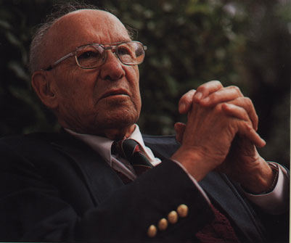
Why is Knowledge Sharing critical?
“The chief economic priority for developed countries is to raise the productivity of knowledge . . . The country that does this first will dominate the twenty-first century economically.”
Peter F. Drucker

Slide 59
Knowledge Sharing is the interplay of people and processes
Provide structure to the things that must be done
Share ideas, have conversations
People
Processes
Create spaces for conversations
Revisit the processes/conversat-ions for what can be done better
Technology
Learning

Slide 60

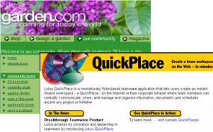
Knowledge sharing needs all of these
People
create knowledge with:
Colleagues
Experts
Customers
Partners and friends
Places
where people can:
Share ideas
Form communities
Learn
Create answers to problems
Things
structured and unstructured content we:
Create
Classify
Capture
Share

Slide 61
Communities of Practice
Communities of practice share ideas. They are about conversations.
Networks and communities of practices are groups of workers with shared interests who meet to share ideas and create knowledge.

Slide 62
Scale
Technology lets us collaborate on a large scale.
“I need someone to explain this to me.”
e-Mail
Discussion database
Portal
Groupware
“I need to know.”
Searching
Mining
“We need a place to work on this.”
Collaboration
Communities

Slide 63
THE KNOWLEDGE ORGANIZATION
KM PROCESS
Creates
Captures
Organizes (codifying, cataloging, etc.)
Refines (collaborating, mining, etc.)
Disseminate (Transfer, share, alert, push, etc.)
Maintains

Slide 64
The whole is greater than the sum of its parts
Knowledge lives in communities and networks.
Group knowledge is more powerful than individual knowledge.
Knowledge sharing needs trust – which comes with experience

Slide 65
Why don’t people share?
It’s not convenient.
They don’t know what they know.
They don’t know the value of what they know.
They believe knowledge hoarding is job security.
They don’t get credit for it.
They don’t have the time.
Knowledge Management Magazine, January 2000

Slide 66
Why do people share?
They take pride in their expertise.
They enjoy interacting with peers.
They wish to learn.
They expect others to reciprocate.
They want to contribute to the common good.
Their culture encourages sharing.
They are loyal to the organization.
Program Management 2000: Know the Way (modified)

Slide 67
KM System Classes
Dynamic Systems
Process-Oriented
Integrative
Locate know carriers and seekers
Create social forum
Access to experts
Support cross functional teams
Provide cross-skills set for projects
Expert NW
Comm. Of Practice
Yellow Pages
Capture Know for reuse in recurrent problems
Improve processes
Lessons learned from best practice
Process description DB
Knowledge repositories
Integrate knowledge source and provide single point of access
Corporate portals (extranets and intranets

Slide 68
Knowledge Organization KM Systems - Insights
If we make it everyone’s job, no one will do it.
Must be meaningful to the user and facilitate the creation, retrieval and sharing of knowledge
It has to integrated into the work people are doing anyway (it can’t be an extra step)
It should support searching and browsing
May employ a controlled vocabulary
Can purchase Taxonomy Vocabulary

Slide 69
Enterprise Information Management
“An integrative discipline for structuring, describing and governing information assets across organizational and technological boundaries to improve efficiency, promote transparency and enable business insight.” (Gartner, 7/09)
This is about the data, documents, files – not knowledge!

Slide 70
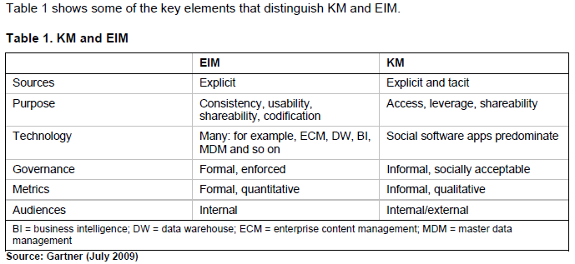
Enterprise Information Management vs Knowledge Management

Slide 71
Trends – Moving from separate systems to Converged Systems
UCC + KM + ERP + DATA = separate systems, less innovation
Need
Tools to leverage collaboration, communication, connection
“Social communications”
Designed to support workflows
Integrate asynchronous communications (email, blogs, wiki, activity feeds)
With synchronous communications ( presence, voice, video, web collaboration) and
Shared workspaces/content stores
Regardless of device, location or time
Notes:
UCC- Unified Communication and Collaboration
KM- Knowledge Management
ERP – Enterprise Resource Planning

Slide 72
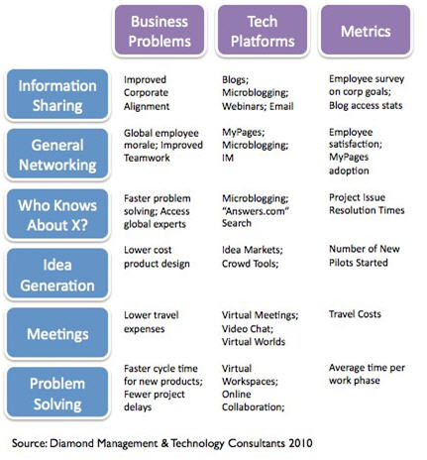
Technology as Enabler

Slide 73
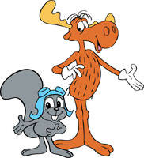
Essentials of a Collaboration Environment
Organize the collaboration
Organize the collective learning
Access to the collective learning by others
…..
Content Management Systems

Slide 74
ECMs
ECM is an umbrella term representing a vision and a framework for integrating a broad range of content management technologies, encompassing document management, records management, and web content management.
In a KM context, content management is a way to organize and control information artifacts that contain valuable intellectual capital that can be written down, made explicit or otherwise captured in text and pictures.

Slide 75
CMS Implementation
Need to focus on non-technology issues
Policies, taxonomies, change management, governance
E-discovery is an emerging need
Video will become common content type
Mobile content delivery is big

Slide 76
Generating Community in the Enterprise
What's the problem we are trying to solve?

Slide 77
Social Technologies
any technology that facilitates social interactions and is enabled by a communications capability
Notes:
Social technologies can be defined as any technology that facilitates social interactions and is enabled by a communications capability, such as the Internet or a mobile device.

Slide 78
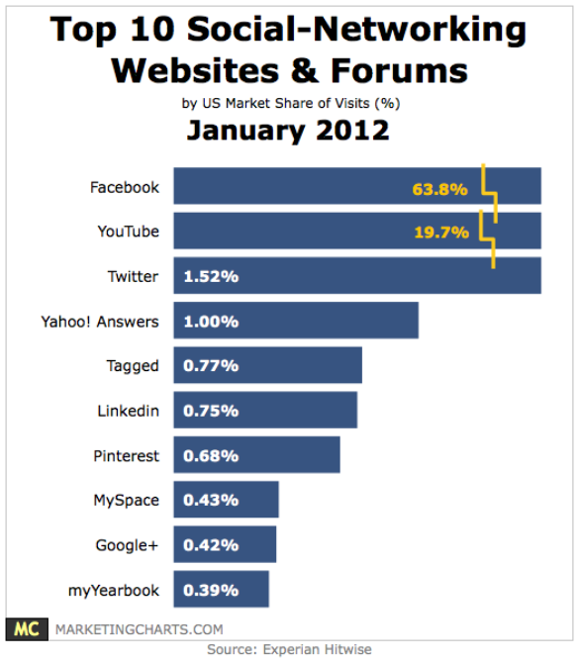
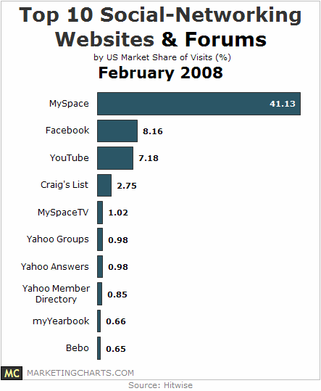
US Market share Top 10 Social Networking Websites
http://www.marketingcharts.com/interactive/top-10-social-networking-websites-forums-february-2010-12248/
Notes:
Note that this slide mixes both SN and SM

Slide 79
Gartner Recommends
Do not dismiss social software as a fad or a general productivity plague.
Instead, prepare a strategy and have a realistic understanding of the risks and benefits of social software.
Understand the unique challenges associated with social software and factor them into the decision on when and how to proceed with initiatives.

Slide 80
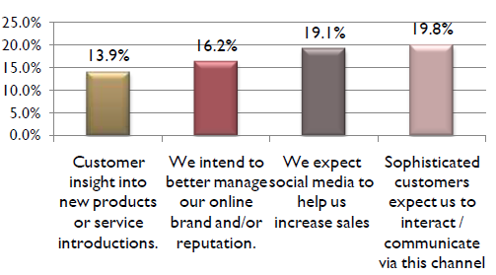
Top Reasons to Invest in Social Community Networks (outward facing)
Hypatia Res. 2011

Slide 81
Current social software
Social Networking
Conversations | Connections
Content | Collaboration
Micro-Blogs
Blogs
Wikis
Project workspaces

Slide 82
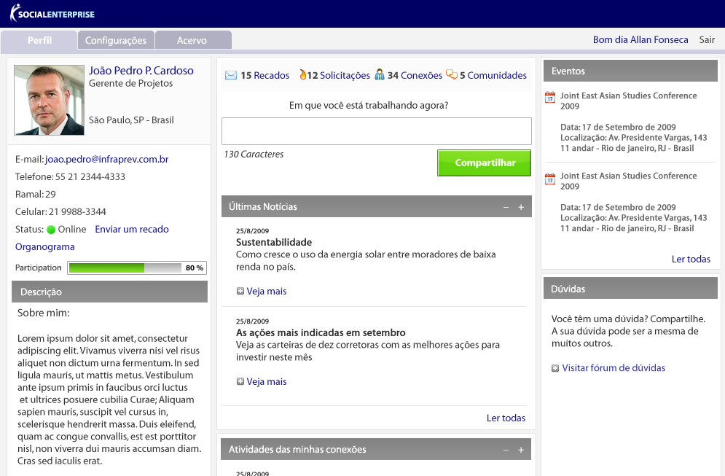
ACTIONS
PROFILE
MESSAGES
CONTACTS
REQUEST
COMMUNITY
INSTANT MESSAGE
PARTICIPATION BAR

Slide 83
Bringing Social Networking into an Enterprise?
What's the problem we are trying to solve?

Slide 84
Strategic Networks promote integration among the departments of a company. This integration is based on five layers: The 5Cs

Slide 85
5 C’s of Strategic Networking
Communication | Content | Connections | Collaboration
Blogs Forums Micro-blogs / Life-streaming Chat/IM VOIP | Content Sharing Content Management Tagging / Rating Social –Bookmarking Syndication | User Profiles Social Graphs Friends/Contacts People Matching | Wikis Workspaces Project / Process Support Innovation / Idea Generation Calendars & Events
Community

Slide 86
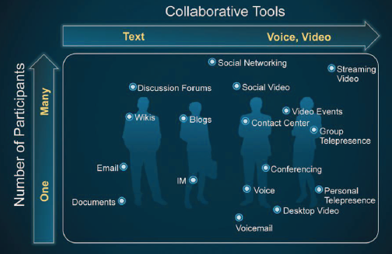

Slide 87
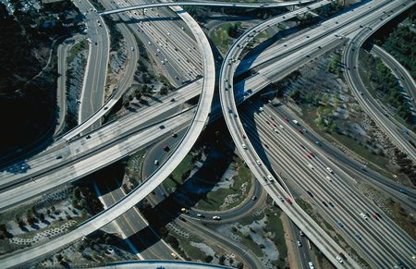
What are the Implications of all this on Enterprise Infrastructure?

Slide 88
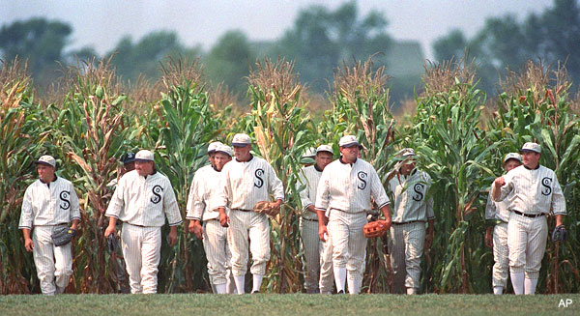
Another Factor to consider -- Adoption
So we build it – will they come?

Slide 89
Adoption of Enterprise 2.0 Tools
This is change management, pure and simple
“Technology change projects succeed if and only if two conditions are met: there is a clear problem to solve; and the cost of the project is less than the perceived cost of changing from the status quo.” – pip coburn

Slide 90
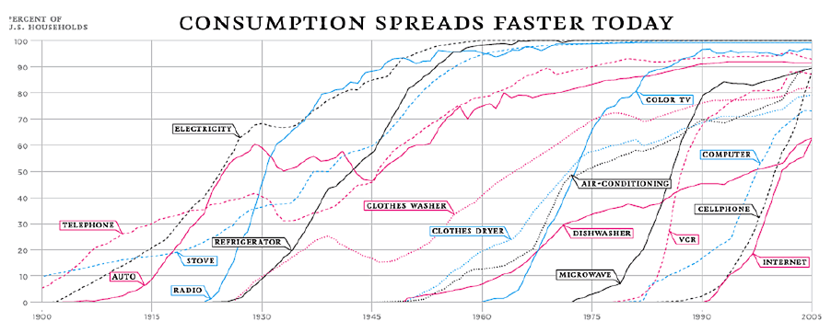
Adoption of General Technology
NY Times, 2/10/2008
Notes:
Adopter Categories
Rogers' defines an adopter category as a classification of individuals within a social system on the basis of innovativeness. In the book Diffusion of Innovations Rogers' suggests a total of five categories of adopters in order to standardize the usage of adopter categories in diffusion research. It should be noted that the adoption of an innovation follows an S curve when plotted over a length of time. The categories of adopters are: innovators, early adopters, early majority, late majority, and laggards ^{[4]}
Innovators
Innovators are the first individuals to adopt an innovation. Innovators are willing to take risks, youngest in age, have the highest social class, have great financial lucidity, very social and have closest contact to scientific sources and interaction with other innovators.
Early Adopters
This is second fastest category of individuals who adopt an innovation. These individuals have the highest degree of opinion leadership among the other adopter categories. Early adopters are typically younger in age, have a higher social status, have more financial lucidity, advanced education, and are more socially forward than late adopters (Rogers, 1964, p.185).
Early Majority Individuals in this category adopt an innovation after a varying degree of time. This time of adoption is significantly longer than the innovators and early adopters. Early Majority tend to be slower in the adoption process, have above average social status, contact with early adopters, and show some opinion leadership
Late Majority Individuals in this category will adopt an innovation after the average member of the society. These individuals approach an innovation with a high degree of skepticism and the majority of society has to have adopted the innovation. Late Majority are typically skeptical about an innovation, have below average social status, very little financial lucidity, in contact with others in late majority and early majority, very little opinion leadership.
Laggards Individuals in this category are the last to adopt an innovation. Unlike some of the previous categories, individuals in this category show little to no opinion leadership. These individuals typically have an aversion to change-agents and tend to be advanced in age. Laggards typically tend to be focused on “traditions”, have lowest social status, lowest financial fluidity, oldest of all other adopters, in contact with only family and close friends, very little to now opinion leadership.

Slide 91
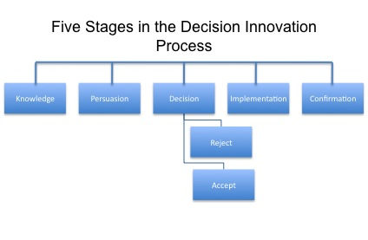
Roger,s 1963
Notes:
Rogers -- The Adoption Process -- 1963 – Iowa State College – based on seed corn hybrid adoptions – Diffusion of Innovations.
Diffusion of an innovation occurs through a five–step process. This process is a type of decision-making. It occurs through a series of communication channels over a period of time among the members of a similar social system. Ryan & Gross first indicated the identification of adoption as a process in 1943 ^{[2]}. Rogers’ categories the five stages (steps) as: awareness, interest, evaluation, trial, and adoption. It should be noted that an individual might reject an innovation at anytime during or after the adoption process. In later editions of the Diffusion of Innovations Rogers’ changes the terminology of the five stages to: knowledge, persuasion, decision, implementation, and confirmation. However the descriptions of the categories have remained similar throughout the editions.
Five Stages of the Adoption Process
Knowledge In this stage the individual is first exposed to an innovation but lacks information about the innovation. It should be noted that during this stage of the process the individual has not been inspired to find more information about the innovation.
Persuasion
In this stage the individual is interested in the innovation and actively seeks information/detail about the innovation.
Decision
In this stage the individual takes the concept of the innovation and weighs the advantages/disadvantages of using the innovation and decide whether to adopt or reject the innovation. Due to the individualistic nature of this stage Rogers’ notes that it is the most difficult stage to acquire empirical evidence (Rogers, 1964, p. 83).
Implementation In this stage the individual employs the innovation on a varying degree depending on the situation. During this stage the individual determines the usefulness of the innovation and may search for further information about it.
Confirmation
Although the name of this stage may be misleading, in this stage the individual finalizes their decision to continue using the innovation and may use the innovation to its fullest potential.

Slide 92
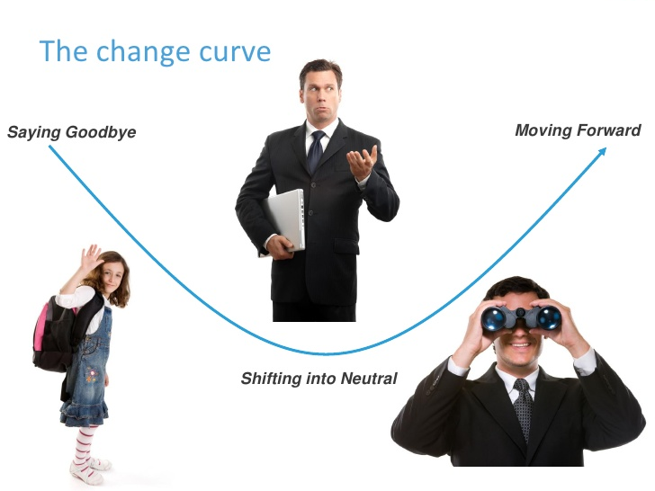
Change Curve

Slide 93
Technology Acceptance Model
Technology Acceptance Model
Predicts short-term use after first exposure
Not explanatory
Not a general model of change
Can’t explain abandonment
Ease of Use
System Use
Usefulness

Slide 94
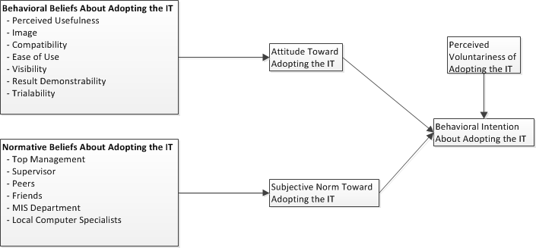
IT Adoption
Karahanna, Straub, Chervany, 1999

Slide 95
Willingness to Change
The Value-Frequency Model
Perceived Frequency of Value
*
Willingness to Change
+
Perceived Net Value
*
Economic
Political
Social
Cognitive
Affective
Physical
Certainty
About
Perceptions
Perceived Value of Transition
Briggs, 2006

Slide 96
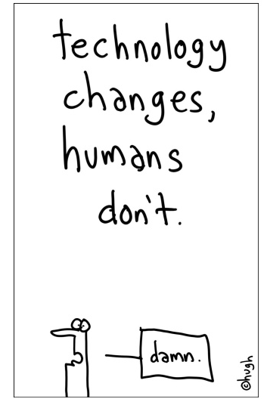
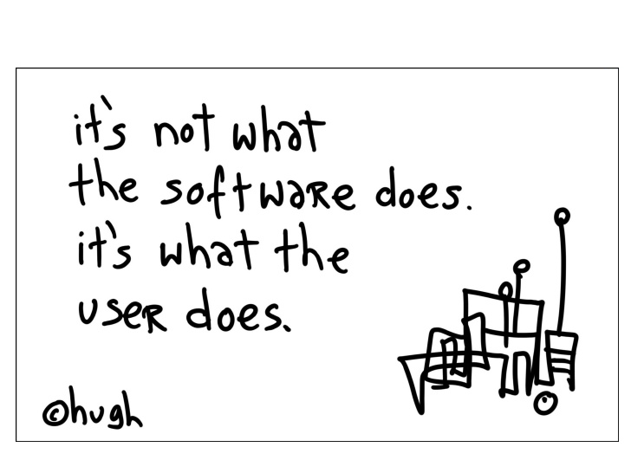
Willingness to Change

Slide 97
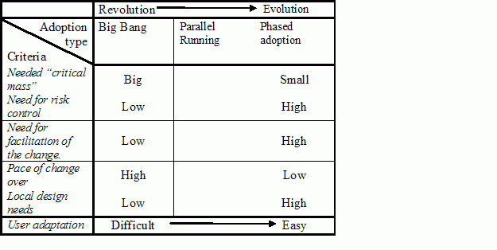
In the case of technology change
effective communication is central to the transformation process.
Remember: someone is getting something out of the current state of affairs (if they weren’t, it would change)

Slide 98
So how do we get people to use the tools?

Slide 99
Some Organizational Strategies
Top Down Transition
Bottom Up Transition
Key Opinion Leader Transition
Self Selected Elite Transition

Slide 100
How does all of this affect the Infrastructure?
Where does it put pressure?
What can be done?

Slide 101
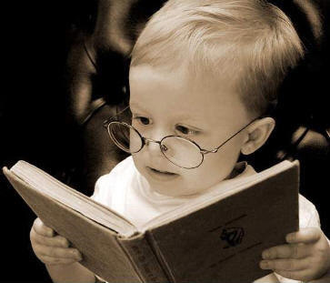
Readings
Any comments on the readings?

Slide 102
Assignments
Reflection Essay will be released on D2L on Thursday this week and will be due by next Thursday (July 16, 9 pm).
The final exam will be released to D2L ONLY after Reflection Essay is turned in and at the end of Module 10. (July 16, 9pm) It is due July 19, 11:30 pm (end of Summer I).
Check D2L for exact dates and times.
Do NOT miss these deadlines (you cannot email it to me)

Slide 103
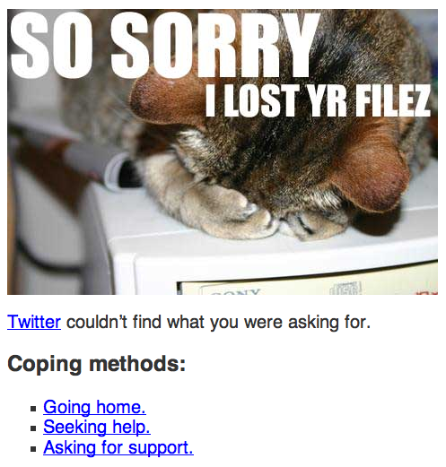
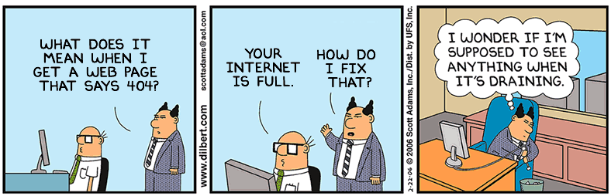
http://www.plinko.net/nevermore.htm

